Slide 1
Employee Data Analysis using Excel
STUDENT NAME:P.Archana
REGISTER NO:asunm110312201304
DEPARTMENT:B COM General
COLLEGE: DRBCCC HINDU college

Slide 2
PROJECT TITLE
Employee Performance Analysis using Excel

Slide 3


AGENDA
Problem Statement
Project Overview
End Users
Our Solution and Proposition
Dataset Description
Modelling Approach
Results and Discussion
Conclusion
3/21/2024 Annual Review

Slide 4

PROBLEM STATEMENT
"Analyzing employee preferences to determine the most desired benefits package. The data includes information on employee demographics, job roles, and preferences for various benefits such as healthcare, retirement plans, and vacation days. The goal is to identify trends and patterns in employee preferences to optimize the benefits package offered by the company."

Slide 5

PROJECT OVERVIEW
* Analyzing employee preferences in Excel involves organizing data on demographics, job roles, and benefit preferences. By examining this information, patterns and trends can be identified to tailor the company's benefits package effectively
.
* This analysis helps in understanding what benefits are most valued by employees, enabling the company to make informed decisions to enhance employee satisfaction and retention.

Slide 6

WHO ARE THE END USERS?
The end users in this project are the employees of the company whose preferences and feedback are being analyzed to optimize the benefits package. Their demographics, job roles, and benefit preferences are the key data points being studied to identify trends that will ultimately benefit the employees by enhancing the company's benefits offering.

Slide 7

OUR SOLUTION AND ITS VALUE PROPOSITION
* The solution we are working on is to analyze employee preferences using Excel to improve the benefits package.
* By understanding what benefits are most valued by employees, we can tailor the package to better meet their needs.
* This will lead to increased employee satisfaction and retention, ultimately benefiting both the employees and the company.

Slide 8
Dataset Description
The dataset we have for the employee preference analysis using Excel includes details about employee demographics, job roles, and benefit preferences. This data will help us dig into what benefits employees value the most, allowing us to tailor the benefits package to meet their needs effectively. By analyzing this information, we aim to enhance employee satisfaction and retention within the company.

Slide 9

THE "WOW" IN OUR SOLUTION
We're on track to revamp the benefits package by analyzing employee preferences in Excel. By tailoring the benefits to what employees truly value, we're set to enhance their satisfaction and loyalty. This strategic move will not only benefit the employees but also contribute to the overall success of the company.
3/21/2024 Annual Review
9

Slide 10
MODELLING
1. Data Acquisition: Downloaded a dataset from the IBM Skills Build Dashboard, which included features like User ID, Name, Gerider, Employee Type, and Department.
2. Data Preparation: "Imported the dataset into Excel. "Cleaned the data to correct any inconsistencies or errors. 3. Initial Exploration: "Reviewed the dataset to understand its structure. "Used summary statistics to gain preliminary insights.
10

Slide 11
. Feature Analysis: 4 Employee lupe: Analyzed the distribution of employee types (Permanent, Fixed-term, Temporary) by applying filters and using Excel formulas like COUNTIF to count each type. Applied conditional formatting to visually distinguish between different employee types. Department: 5. Data Visualization: "Created visualizations to illustrate the data: Pie Charts: Displayed the proportion of different employee types and departmental distribution. Bar/Column Charts: Compared the number of employees by type and department Graphs: (If applicable) Analyzed trends over time.

Slide 12
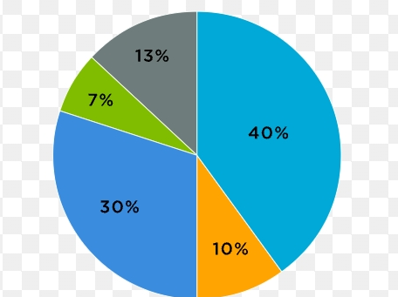
RESULTS
12

Slide 13
conclusion
We're on track to revamp the benefits package by analyzing employee preferences in Excel. By tailoring the benefits to what employees truly value, we're set to enhance their satisfaction and loyalty. This strategic move will not only benefit the employees but also contribute to the overall success of the company.
We're all set to upgrade the benefits based on employee preferences in Excel. By aligning benefits with what employees want, we're primed to boost their happiness and loyalty. This shift will not only benefit the team but also drive success for the company.

